Slide 1
A common neural basis for contrast and motion coherence discrimination
Dan Birman
Frisem 2017-06-26

Slide 4
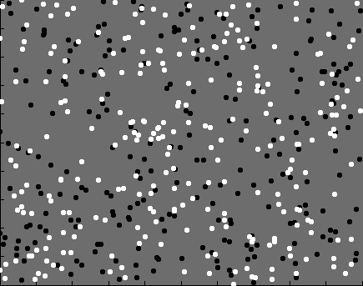

Slide 5
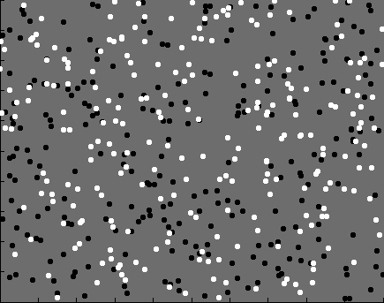
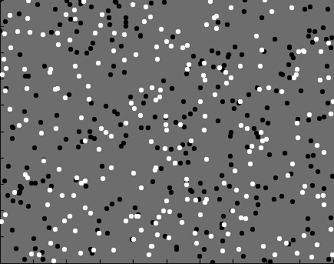
Contrast

Slide 6
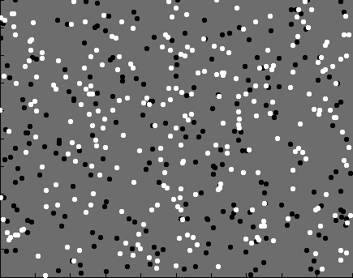
Coherence

Slide 7


Slide 8
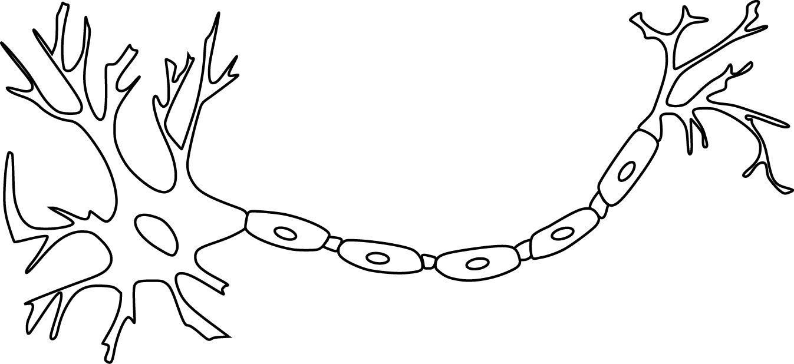

Slide 10
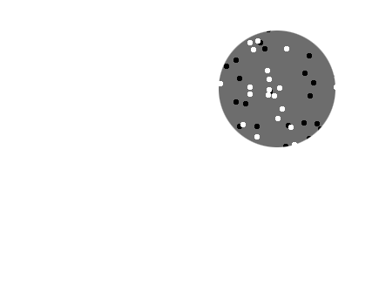
Receptive field

Slide 11
Receptive field

Slide 12
Population
Receptive field

Slide 14
~ 2.5 mm
~ 2.5 mm
~ 2.5 mm

Slide 15
~ 2.5 mm
~ 2.5 mm
~ 2.5 mm
Millions of neurons

Slide 17
Representation of contrast?
Boynton et al. 1999

Slide 18
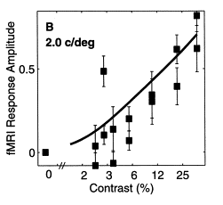
Representation of contrast?
Boynton et al. 1999

Slide 19
Representation of contrast?
Boynton et al. 1999
Representation of coherence?
Rees and Koch 2000

Slide 20
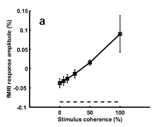
Representation of contrast?
Boynton et al. 1999
Representation of coherence?
Rees and Koch 2000

Slide 21
Representation of contrast?
Boynton et al. 1999
Representation of coherence?
Rees and Koch 2000

Slide 24
Contrast

Slide 25
Contrast

Slide 26
Contrast

Slide 27
Contrast
Coherence

Slide 28
Contrast
Coherence

Slide 29
Contrast
Coherence

Slide 30
Contrast
Coherence

Slide 31
Goal: A model of how voxels represent (encode) contrast and motion coherence

Slide 32
Goal: A model of how voxels represent (encode) contrast and motion coherence
Voxel representation from cortical measurements of BOLD fMRI
Prediction and comparison to a behavioral measure of visibility

Slide 33
Goal: A model of how voxels represent (encode) contrast and motion coherence
Voxel representation from cortical measurements of BOLD fMRI
Prediction and comparison to a behavioral measure of visibility

Slide 34
Goal: A model of how voxels represent (encode) contrast and motion coherence
Voxel representation from cortical measurements of BOLD fMRI
Prediction and comparison to a behavioral measure of visibility

Slide 38
Luminance changes = bad

Slide 44
Cortical measurements: task at fixation

Slide 45
Cortical measurements: task at fixation
11 observers, asynchronous task at fixation
800+ trials (20 per experimental condition)
1 hr retinotopy
4 x 2 hr scanning sessions

Slide 46
Area V1
Area MT

Slide 48
Within-subject analysis: display average across subjects

Slide 49
Within-subject analysis: display average across subjects
Timecourses were averaged across ROIs

Slide 50
Within-subject analysis: display average across subjects
Timecourses were averaged across ROIs
Deconvolution (GLM/finite impulse response) used to obtain separated per-condition measurements

Slide 52
Contrast

Slide 53
Contrast
Coherence

Slide 54
Contrast
Stimulus length
Coherence

Slide 68
Contrast

Slide 69
Contrast
Coherence

Slide 70
Contrast
Stimulus length
Coherence

Slide 73
Neural response model for cortical measurements

Slide 76
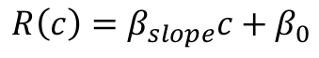
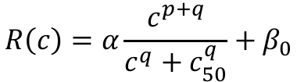
$$R\left(c\right)=β_{slope}c+β_{0}$$
$$R\left(c\right)=α\frac{c^{p+q}}{c^{q}+c_{50}^{q}}+β_{0}$$

Slide 77
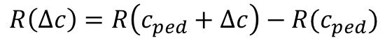
$$R\left(c\right)=β_{slope}c+β_{0}$$
$$R\left(c\right)=α\frac{c^{p+q}}{c^{q}+c_{50}^{q}}+β_{0}$$
$$R\left(Δc\right)=R\left(c_{ped}+Δc\right)−R(c_{ped})$$

Slide 78
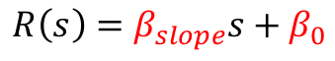
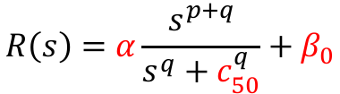
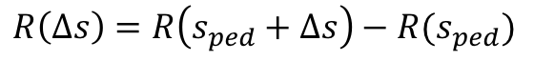
$$R\left(s\right)=β_{slope}s+β_{0}$$
$$R\left(s\right)=α\frac{s^{p+q}}{s^{q}+c_{50}^{q}}+β_{0}$$
$$R\left(Δs\right)=R\left(s_{ped}+Δs\right)−R(s_{ped})$$
$$E\left({Δs}_{con},Δs_{coh}\right)=R\left(Δs_{con}\right)+R\left(Δs_{coh}\right)+R_{onset}$$

Slide 79
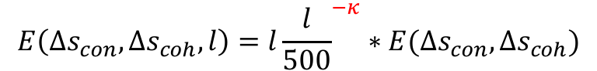
$$E\left({Δs}_{con},Δs_{coh},l\right)=l{\frac{l}{500}}^{−κ}∗E(Δs_{con},Δs_{coh})$$

Slide 84
Goal: A model of how voxels represent (encode) contrast and motion coherence
Voxel representation as measured from cortical signals with fMRI
Prediction and comparison to a behavioral measure of visibility

Slide 85
Goal: A model of how voxels represent (encode) contrast and motion coherence
Voxel representation as measured from cortical signals with fMRI
Prediction and comparison to a behavioral measure of visibility

Slide 88
11 fMRI observers, 21 behavioral observers (1000—2500 trials)

Slide 99
Neural response model for behavioral measurements

Slide 103
$$T\left(s\right)=β_{con}R\left(Δs_{con}\right)+β_{coh}R\left(Δs_{coh}\right)+β_{bias}$$

Slide 105
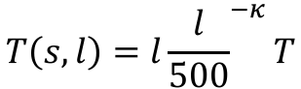
$$T\left(s,l\right)=l{\frac{l}{500}}^{−κ}T$$

Slide 107
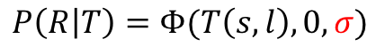
$$P\left(R | T\right)=Φ(T\left(s,l\right),0,σ)$$

Slide 108
Smaller sigma
(less noise)
$$P\left(R | T\right)=Φ(T\left(s,l\right),0,σ)$$

Slide 109

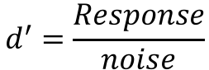
Smaller sigma
(less noise)
$$d^{′}=\frac{Response}{noise}$$
$$P\left(R | T\right)=Φ(T\left(s,l\right),0,σ)$$

Slide 110
Response model:
Linear vs. nonlinear

Slide 111
Response model:
Linear vs. nonlinear
Noise model:
Additive vs. poisson

Slide 112
Response amplitude (s.d.)
Stimulus strength (%)

Slide 113
Response amplitude (s.d.)
Stimulus strength (%)

Slide 114
Response amplitude (s.d.)
Stimulus strength (%)

Slide 115
Response amplitude (s.d.)
Stimulus strength (%)

Slide 116
Response amplitude (s.d.)
Stimulus strength (%)

Slide 117
Response amplitude (s.d.)
Stimulus strength (%)

Slide 121
Response amplitude (s.d.)
Stimulus strength (%)

Slide 122
Response amplitude (s.d.)
Sensitivity = Response / Noise
Stimulus strength (%)

Slide 126
Response amplitude (s.d.)
Stimulus strength (%)

Slide 132
Goal: A model of how voxels represent (encode) contrast and motion coherence
Voxel representation as measured from cortical signals with fMRI
Prediction and comparison to a behavioral measure of visibility

Slide 133
Goal: A single model of how voxels represent (encode) contrast and motion coherence
Voxel representation as measured from cortical signals with fMRI
Prediction and comparison to a behavioral measure of visibility

Slide 134
Goal: A single model of how voxels represent (encode) contrast and motion coherence
Voxel representation as measured from cortical signals with fMRI
Prediction and comparison to a behavioral measure of visibility

Slide 135
Goal: A single model of how voxels represent (encode) contrast and motion coherence
Voxel representation as measured from cortical signals with fMRI
Evidence for similar neural response functions to contrast and motion coherence
Prediction and comparison to a behavioral measure of visibility

Slide 136
Goal: A single model of how voxels represent (encode) contrast and motion coherence
Voxel representation as measured from cortical signals with fMRI
Evidence for similar neural response functions to contrast and motion coherence
Prediction and comparison to a behavioral measure of visibility

Slide 137
Goal: A single model of how voxels represent (encode) contrast and motion coherence
Voxel representation as measured from cortical signals with fMRI
Evidence for similar neural response functions to contrast and motion coherence
Prediction and comparison to a behavioral measure of visibility
Judgments of contrast and motion coherence appear to be read out from early visual cortex and MT in a similar way

Slide 138

Thanks!
Another person involved in this project:
Justin Gardner

